Slide 1
A Look At CIS Security Benchmarks (4)
CIS Benchmarks example (Operating Systems)
MS Windows Server 2012-R2

Slide 2
A Look At CIS Security Benchmarks (4)
# | OVERALL CIS BENCHMARK CATEGORIES | TOTAL
1 | OPERATING SYSTEMS | 36
2 | SERVER SOFTWARE | 33
3 | CLOUD PROVIDERS | 2
4 | MOBILE DEVICES | 8
5 | NETWORK DEVICES | 6
6 | DESKTOP SOFTWARE | 21
7 | MULTIFUNCTION PRINT DEVICES | 1
 | GRAND TOTAL CIS BENCHMARKS | 107

Slide 3
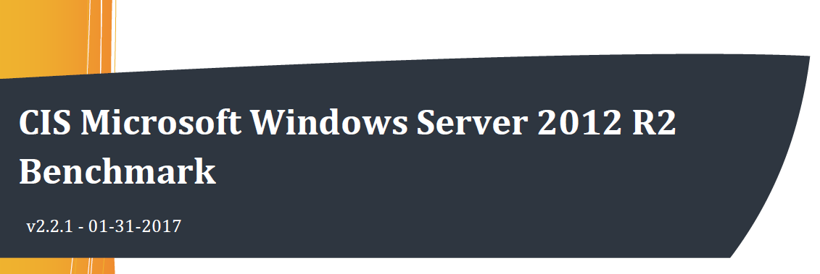
A Look At CIS Security Benchmarks (4)
January 31, 2017
760 pages PDF doc

Slide 4
A Look At CIS Security Benchmarks (4)
Profile applicability:
Level 1 domain controller
Level 1 member server
Level 2 domain controller
Level 2 member server

Slide 5
A Look At CIS Security Benchmarks (4)
Level 1: Items in this profile intend to:
be practical and prudent;
provide a clear security benefit; and
not inhibit the utility of the technology beyond acceptable means

Slide 6
A Look At CIS Security Benchmarks (4)
Level 2: extends the Level 1 - profile
intended for environments or use cases where security is paramount
acts as defense in depth measure
may negatively inhibit the utility or performance of the technology

Slide 7
A Look At CIS Security Benchmarks (4)
Control content:
Profile applicability (ASA 8.X, ASA 9.X)
Description
Rationale
Audit
Remediation
Impact
Default value
References

Slide 8
A Look At CIS Security Benchmarks (4)
1.1.2 [L1]: Ensure 'Maximum password age' is set to '60 or fewer days, but not 0' (Scored)
Profile applicability: Level 1 Domain Controller, Level 1 Member Server

Slide 9
A Look At CIS Security Benchmarks (4)
1.1.2 [L1] Description:
This policy setting defines how long a user can use their password before it expires.
Values for this policy setting range from 0 to 999 days. If you set the value to 0, the password will never expire.

Slide 10
A Look At CIS Security Benchmarks (4)
1.1.2 [L1] Audit:
Navigate to the UI Path articulated in the Remediation section and confirm it is set as prescribed.

Slide 11
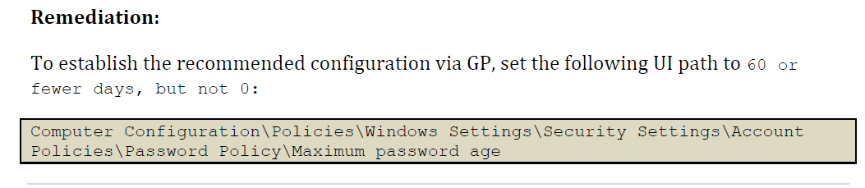
A Look At CIS Security Benchmarks (4)

Slide 12
A Look At CIS Security Benchmarks (4)
1.1.2 [L1] Default Value: 42 days
1.1.2 [L1] Reference: CCE-37167-4
Common Configuration Enumeration (Unique identifiers for common system config issues)
END

